Slide 1
Inleiding in de informatica
Wednesday 4th December 2024

Slide 2
Herhaling
Welke data type zou je het best kunnen gebruiken om het aantal stappen van een persoon bij te houden?
A. int
B. boolean
C. float
D. double
E. Geen van bovengenoemde antwoorden

Slide 3
Boolean Expressions
A Boolean expression is a logical statement that can only evaluate to true or false. These expressions are the foundation of decision-making in programming and are used to control the flow of a program.
Boolean Values: true and false.
Relational Operators: Compare values.
Examples: ==, !=, <, >, <=, >=
Example: 5 > 3 evaluates to true.

Slide 4
Boolean Expressions
Logical Operators: Combine or modify Boolean values.
AND (&&): Both conditions must be true.
Example: (5 > 3) && (2 < 4) → true
OR (||): At least one condition must be true.
Example: (5 > 3) || (2 > 4) → true
NOT (!): Inverts a Boolean value.
Example: !(5 > 3) → false

Slide 5
Example
Welke Boolean expression komt overeen met de stelling “er zijn minder dan 10 getallen en de som is meer dan 100”?
A. ((Getallen <= 10) && (Som >= 100))
B. ((Getallen < 10) || (Som > 100))
C. ((Getallen < 10) && (Som > 100))
D. ((Getallen <= 10) || (Som >= 100))
E. Geen van bovengenoemde antwoorden

Slide 6
Example
Welke Boolean expression komt overeen met de stelling “de persoon is 18 jaar of ouder en is langer dan 180 cm”?
A. ( !(Leeftijd <= 18) && !(Lengte < 180) )
B. ( (Leeftijd >= 18) && (Lengte > 180) )
C. ( !(Leeftijd <= 18) && (Lengte >= 180))
D. ( (Leeftijd >= 18) && (Lengte < 180))
E. Geen van bovengenoemde antwoorden

Slide 7
Using Functions and Classes
Declare Functions
Calling Functions

Slide 8
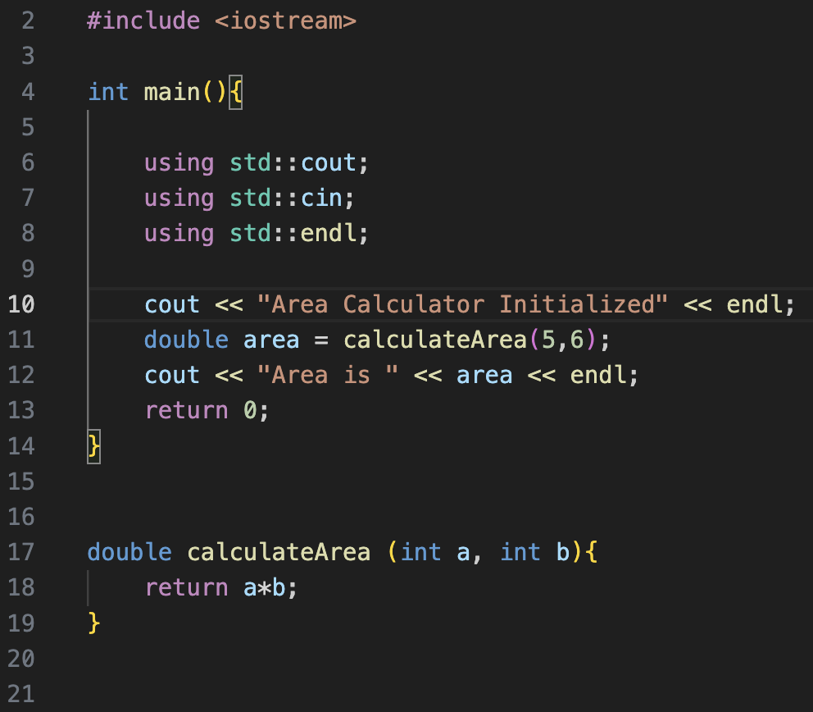
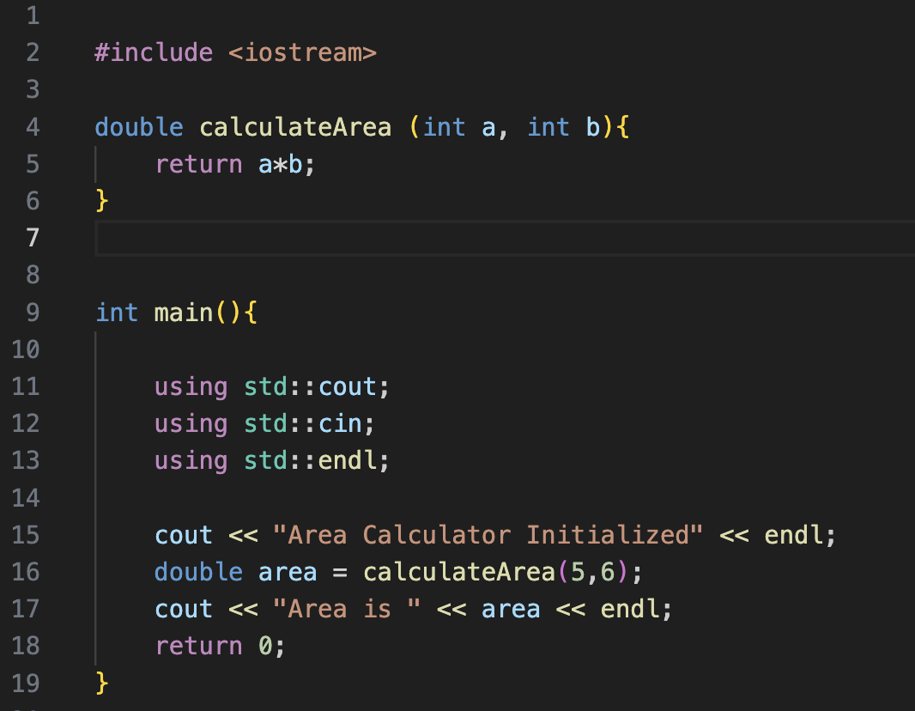
Function Orders

Slide 9
Loops
Loops in C++ are constructs that allow you to execute a block of code repeatedly as long as a certain condition is true or for a specified number of times. Here are the three main types of loops in C++: for, while, and do-while.

Slide 10
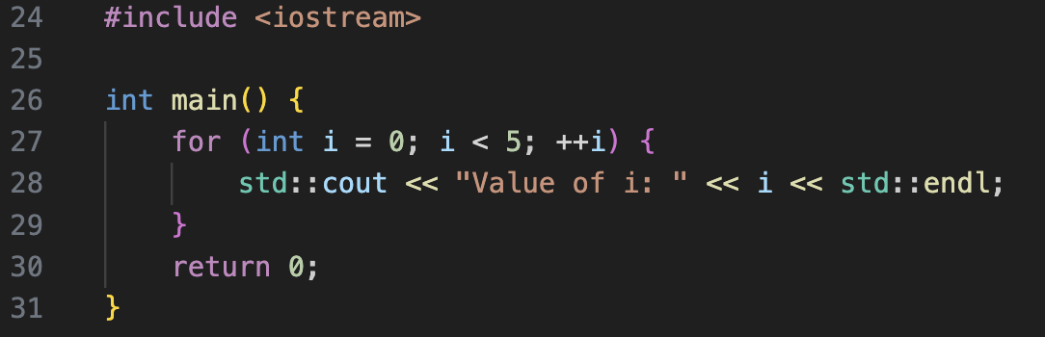
For Loop
The for loop is often used when you know in advance how many times you want to execute a block of code.

Slide 11
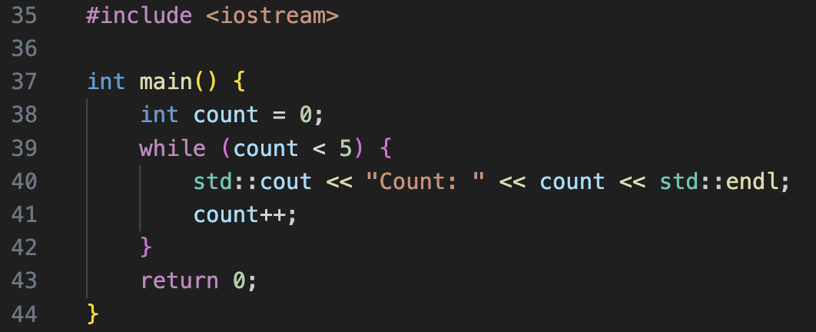
Do-While Loop
The do-while loop is similar to the while loop, but it always executes the block of code at least once, even if the condition is false.

Slide 12
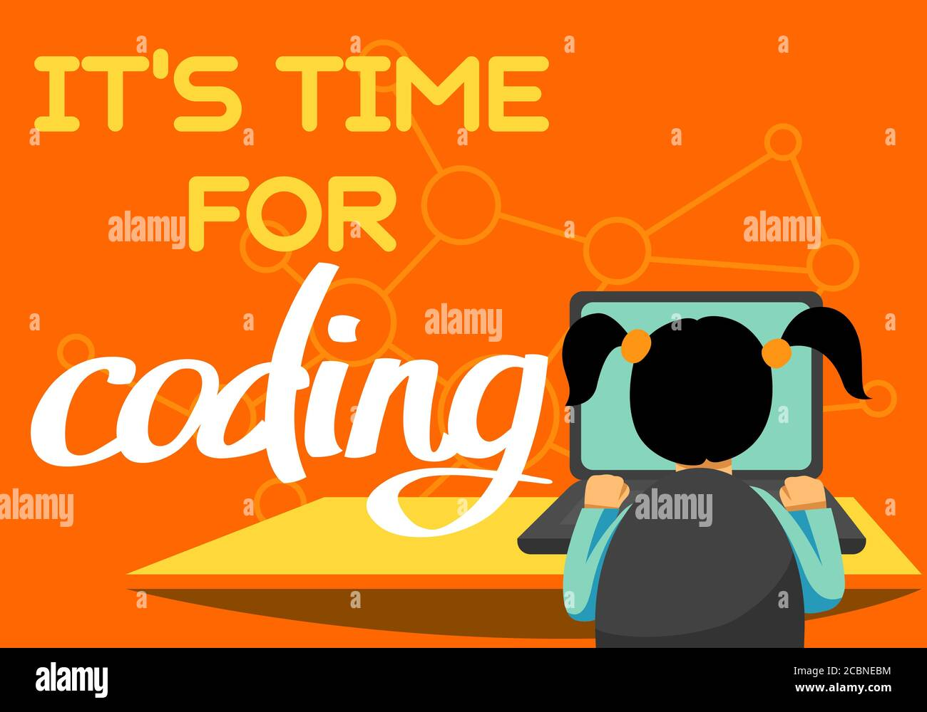
Print Multiplication Table

Slide 13
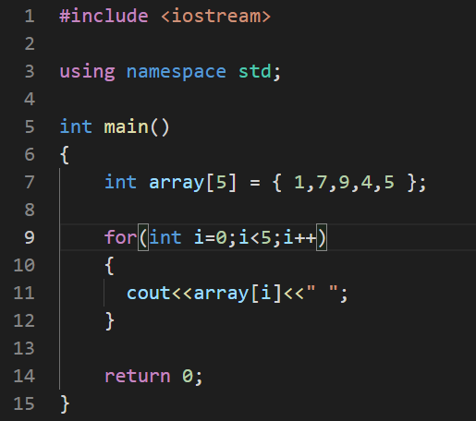
Next week – Data Structure(Arrays)

Slide 14
Vragen?

